Slide 1
Using Forensic Evidence in probing Abuses Cases against children in family court.
National Judicial Institute
2024 Child Rights Conference

Slide 2
Background
Nigeria has high prevalence of sexual violence against children; it affects 6 out of 10 girls and 1 in 10 boys.
Child sexual abuse cases can be some of the most complex and difficult to handle.
Minors die to immaturity often behave in a manner that is contrary to what would be expected.
- Minors often only disclose abuse long after the incident.
- Often takes place in secret, with no witnesses.
- Minors cannot give testimony to same standard as adult

Slide 3
Why Forensic medical evidence ?
Hair and saliva: identify suspect; link suspect to victim and/or crime scene.
Semen: identify the suspect; link the suspect to victim and/or crime scene; indicate sexual activity.
Bleeding, discharge, pain, behaviour changes: may indicate abuse
Bruising, abrasions, lacerations, bite marks: may indicate use of force; may indicate resistance.
Genital or anal tears, abrasions, redness: may indicate penetration or use of force

Slide 4
But there are limitations …
Child sexual abuse can be difficult to medically diagnose.
Properly interpreting physical findings, or the lack thereof, requires medical experts specifically trained in child sexual abuse identification.
Medical evidence cannot confirm whether a sexual act was consensual or not…immaterial when it involves a child.
Absence of medical evidence doesn’t mean that nothing happened

Slide 5
Absence of medical evidence doesn’t mean nothing happened
definitive signs of genital trauma are seldom seen in cases of child sexual abuse (International research- Bays and Chadwick [1993] & Heger et al. [2002]
Less than 25% showed abnormal findings on exam. Some studies as low as 4%.
Vast majority of forensic medical examinations do not produce any confirmatory physical or laboratory findings to corroborate the minor’s testimony.
Notes:
A meta-analysis by Bays and Chadwick [1993] reported normal findings in more than 50% of abuse victims. In a study by Adams et al. [1994] with the subtitle ‘It’s normal to be normal’, the authors examined 236 children with perpetrator conviction for sexual abuse who had normal genital examination findings in 28%, nonspecific in 49%, suspicious in 9%, and abnormal findings in 14%.
Heger et al. [2002] examined 2,384 children and found normal exams in 95% of children who had disclosed and in 92% in girls who reported penetration.

Slide 6
Absence of medical evidence doesn’t mean nothing happened
Sexual abuse often leaves no physical evidence that can be detected through medical examination.
A "negative" or normal examination does not rule out nor confirm sexual abuse or penetration.
Penetration rarely results in physical evidence of healed injury.

Slide 7
Reasons for lack of medical evidence
Many types of sexual abuse do not include acts that would be expected to cause trauma to skin or body tissues.
If the minor’s injuries were minor and the exam takes place after 72 hours, then it is unlikely that there will be any findings.
Vaginal and anal injuries heal very rapidly, often leaving no trace of injury after as little as 72 hours.
Semen and other samples generally cannot be detected after 72 hours or if the minor has washed.

Slide 8
Reasons for lack of medical evidence
The hymen and anal sphincter are highly elastic and may not be damaged by penetration.
In many cases, child sexual abuse doesn’t leave any sign at all. Extent of injuries will depend on degree of penetration and force used.
Younger children often lack sufficient knowledge about their anatomy to appropriately describe what has occurred, or report penetration when full penetration has not occurred.

Slide 9
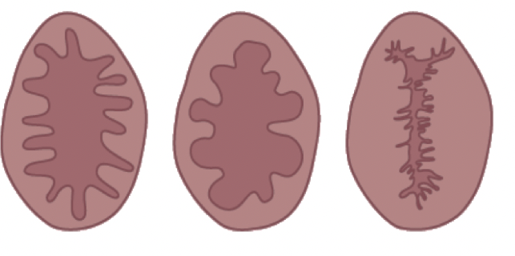
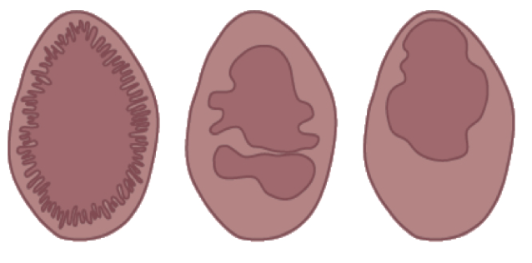
Myths about the hymen
There is no scientific or medical basis for using hymen size or integrity to determine whether a girl has experienced vaginal penetration.
Hymens vary in size, shape and flexibility, and changes throughout a woman’s life.

Slide 10
Myths about the hymen
Hymenal tissue is elastic and penetration may simply stretch the hymenal opening. Only a small portion of adolescent girls will exhibit changes in the hymen as a result of penetration.
US study of adolescent girls who admitted to having intercourse showed 52% had “intact” hymen.
US study of 36 pregnant adolescents – only 2 had definitive medical finding of prior penetration.
In pre-pubertal girls, the hymen is less elastic and trauma caused by penetration is more likely to be evident.

Slide 11
Myths about the hymen
The hymen is a membrane with relatively few blood vessels - even if torn it may not bleed significantly.
Women do not routinely bleed after their first sexual intercourse.
Forced penetration and lack of lubrication may cause lacerations to the vaginal wall, both of which are most likely to be responsible for bleeding rather than trauma to the hymen.

Slide 12
Myths about the hymen
Partial hymenal tears and abrasions heal within a matter of days.
Accidental trauma to the hymenal membrane can occur.
Even for an experienced physician, it may be extremely difficult to differentiate between a healed, partial hymenal tear and a naturally occurring superficial notch.

Slide 13
Common mistakes made by medical examiners
It is common for forensic medical examiners to indicate in their report whether or not a rape has occurred.
This is not the responsibility of the medical examiner:
Medical experts are responsible for documenting injuries, collecting available evidence, and treating injuries
The court will make a judgment as to whether a crime was committed.

Slide 14
Common mistakes made by medical examiners
Over-stating the evidence – e.g. determining the exact age of a bruise by color is not possible.
Thinking that is the exam is normal, abuse has not occurred.
Believing that it’s possible to determine whether a minor has had sex or not.
Trying to measure the size of the hymenal opening, and thinking that if the girl’s hymen is intact, then sexual abuse has not occurred.
Forcing exams on minors.

Slide 15
Common mistakes made by medical examiners
When taking the child’s medical history:
Asking leading questions or questions that are not age-appropriate
Putting their own interpretation on what the minor said rather than documenting their own words
Attempting to interview a child who is frightened or reluctant, or pressing for unnecessary details.
Failing to indicate the source of information (child or parent)
Failing to ask the minor and parents about medical history / behavioural changes that may be indicative of abuse.

Slide 16
Conclusions
In the vast majority of child sexual abuse cases, the medical examination will not reveal any supportive evidence.
Limitations exist as to what, and how much, forensic medical evidence can actually reveal about child sexual abuse.
That is not to say that medical evidence is of no use in sexual abuse trials—it can sometimes play an important role, but the benefits and uses of forensic evidence should not be overstated.

Slide 17
Points to Note…
Accurate interpretation of genital findings in minors requires specialist training.
Forensic medical examinations of suspected child sexual abuse victims should be carried out only by medical examiners with training in identifying signs and symptoms of child sexual abuse.
It is also important for medical examiners, investigators, procuracy and judges to understand the limitations of forensic medical examinations.

Slide 18
Issues and Challenges using Forensic Evidence in Family Courts
Problem of constitution and functionality of family courts.
Role of the Assessors
Interagency partnership between Justice and health
Capacity of Institutions (Health, prosecutors and Judicial offices) on forensic evidence

Slide 19
Thank You

