Slide 1
ORAL & WRITTEN COMMUNICATION SKILLS
By
SHAMSUDDEEN Y. ABDULRAHMAN
Principal Studies Fellow/Special Assistant to the Administrator, NJI, Abuja
UMMUL ABUBAKAR
Research Fellow, Research department, NJI, Abuja
Presented at the National workshop of NJI tagged:
“Promoting Transparency, Productivity and Efficiency in the Judiciary”
10TH AUGUST, 2022

Slide 2
Introduction
Freedom of Expression
2. Need for Effective Communication
Boosting Communication Skills
3. Ways of Improving Written Communication
4. Benefits of Effective Written communication
5. Impediments to Effective Oral & Written Communication
CONTENTS

Slide 3
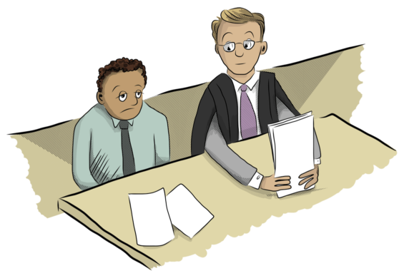
01
INTRODUCTION
Why the emphasis on oral and communication skills in the judiciary at this time?

Slide 4
INTRODUCTION
Mastery of the art of oral & written communication plays a key role in the administration of justice.
Seated in this auditorium are frontline staff of the judiciary:
Confidential secretaries, Executive assistants, Protocol officers, Information desk officers, Public relations officers, and other administrative staff of the judiciary.
As a frontline staff, you will at one point in time interface or be in communication with:
Judges, co-workers, court users – litigants and practitioners
The impression an ordinary person gets from contact with YOU forms the GENERAL PERCEPTION of the Judiciary.
Communication! Communication!! Communication!!!...cannot be overemphasized.

Slide 5
What is communication?
Communication is the process of sharing ideas, information, and messages with others in a particular time and place
Writing and talking
Electronic
(telephone calls, electronic mail, cable television, or satellite broadcasts
MEDIUM OF COMMUNICATION
Nonverbal
(facial expressions, body language, or gestures)
Visual
(images or pictures: painting, photography, video, or film)

Slide 6
THE FREEDOM OF EXPRESSION
The Right to Freedom of Expression and the Press
(Oral and Written)
SECTION 39
1999 Constitution of FRN
Are there restrictions to this right? (YES/NO)
If YES, are these restrictions applicable to Court Employees as in the case of an ordinary citizen?

Slide 7
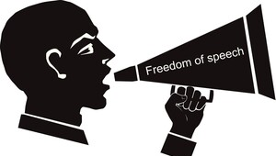
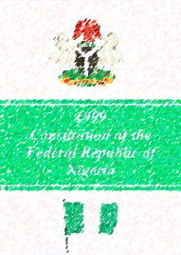
THE FREEDOM OF EXPRESSION
Court employees have the right to freedom of expression
In exercising these rights, we must always remember that our job limits the full application of such rights.
If you reveal or divulge some information available to you in the course of discharging your duties, it may be detrimental to the Administration of Justice.
WHY?
Any constitutional backing?

Slide 8
THE FREEDOM OF EXPRESSION
Pursuant to the provisions of Section 39(3) CFRN 1999 (as amended), the Official Secret Act came into existence. The section states that:
“Nothings in his section shall invalidate any law that is reasonably justifiable in a democratic society
for the purpose of preventing the disclosure of information received in confidence, maintaining the authority and independence of courts or regulating telephony, wireless broadcasting, television or the exhibition of cinematography films; or
imposing restrictions upon persons holding office under the Government of the Federation or of a State, members of the armed forces of the Federation or members of the Nigeria Police Force or other Government security services or agencies established by law.’’

Slide 9
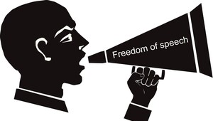
THE FREEDOM OF EXPRESSION
As Court Employees:
Always be circumspect in what you say, do or write
Remember that the Code of Conduct for Court employees expressly provides that Court employees hold a highly visible position of public trust
Your actions do not affect your life alone but also the image of the Court
Improper behaviour or appearance may compromise your professional integrity
Consider the propriety of your action before making any communication
Conduct yourselves in a manner that commands public trust, respect & confidence

Slide 10
02
THE NEED FOR EFFECTIVE COMMUNICATION
It is expected that the information or ideas being conveyed is clear and understandable by the receiver otherwise, communication fails or becomes ineffective.

Slide 11
Effective Communication
01
02
Effective communication involves the proper transmission of accurate information from one person to another
Involves skills which a communicator must constantly hone in order to achieve the intended purpose of communication.
04
Workers in the digital age must know how to effectively convey/receive messages in person, via phone, email, or social media.
Do you issue hearing notices via email/WhatsApp or do you hold virtual hearings?
03
Global turn of events (COVID-19) – Social distancing & Virtual meetings.
Any impact as a result of resulting into alternative means of communication between court employees and users?

Slide 12
Boosting Communication Skills
LISTENING
EMPATHY
NONVERBAL COMMUNICATION
OPEN-MINDEDNESS
CLARITY & CONCISION
RESPECT
FRIENDLINESS
FEEDBACK
PICK THE RIGHT MEDIUM
CONFIDENCE

Slide 13
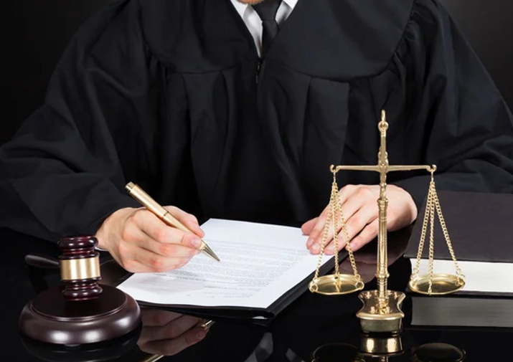
03
WAYS OF IMPROVING WRITTEN COMMUNICATION

Slide 14
Ways of Improving Written Communication
Stop writing, start thinking
01
Write for your audience
02
Use appropriate writing tools
03
Keep it simple
04
State your assumptions
05

Slide 15
Ways of Improving Written Communication
Know that the first draft is a first draft
06
07
Write and read often
08
Edit fiercely
09
Put yourself in your reader's shoes
Don’t forget to proofread
10

Slide 16
04
BENEFITS OF EFFECTIVE WRITTEN COMMUNICATION

Slide 17
Benefit of Effective Written Communication
01
Strengthens interaction with colleagues and clients
02
Prevents irreparable damage - a poorly written message is generally perceived to portray the writer’s intentions.

Slide 18
05
IMPEDIMENTS TO EFFECTIVE
ORAL & WRITTEN COMMUNICATION
Court employees face a lot of challenges in their work. Identifiable impediments to effective communication includes

Slide 19
The use of complex and technical terms in communication
01
01
IMPEDIMENTS
to
Lack of proper understanding of what is to be communicated
02
Effective Oral & Written Communication
02
03
Forgetting to provide feedbacks and regular updates.
Judges and other court users need to be given regular feedback to aid the administration of justice.
03

Slide 20
Physical disabilities such as hearing problems or speech disabilities
04
04
IMPEDIMENTS
to
Language barrier, differences and the difficulty in understanding unfamiliar accents
05
Effective Oral & Written Communication
05
06
06
Lack of attention, interest and distractions

Slide 21
CONCLUSION
Service delivery by Court employees in our dynamic digital world must be top-notch to meet the demands of Court employees and users.
At all times, say, write or comport ourselves in line with the provisions of the Code of Conduct for Court employees
As we write letters, memos, e-mails, messages, we must find a way of taking cognisance of our socio-cultural background.
As Court employees, we must bear in mind that the things we often write on behalf of Judicial Officers have consequences.
A careful inculcation of sound communication skills will accord one a pride of place in a competitive environment.
There are no shortcuts - Good writing involves exertion!
Your oral and written communication skill is an asset that you must cherish and hone every day.

Slide 22
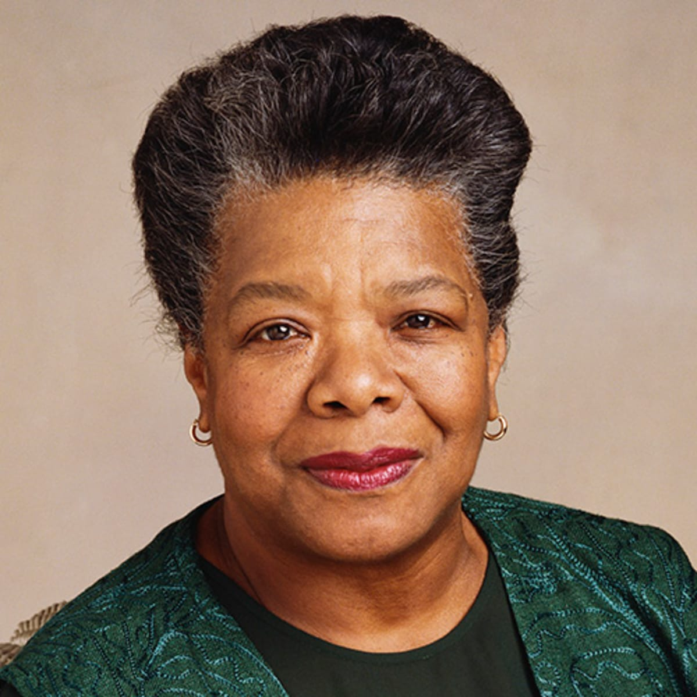
Maya Angelou
“easy reading is damn hard writing”

Slide 23
Thank You for Listening!

