Slide 1
Mental Health and Healthy Living for Judges

Slide 2
Dr. C.A.T.Cudjoe
HOLBROOK FELLOW Harvard University
PRESIDENT
The Byron Institute Nigeria
CHIEF MEDICAL DIRECTOR
The Chasel Hospital.

Slide 3
Judges are responsible for high-stakes decisions, frequently under intense pressure. This role, while critical to the justice system, can significantly affect mental health.

Slide 4
Scope of the Presentation:

Slide 5
This presentation will explore mental health issues specific to the judiciary, particularly in Nigeria, while highlighting strategies for promoting healthy living.
We will also reference global data for a broader perspective.

Slide 6
Understanding Mental Health in a Judicial Context

Slide 7
What is Mental Health?
According to the WHO, mental health is "a state of well-being in which an individual realizes their own potential, can cope with the normal stresses of life, can work productively, and can contribute to their community."

Slide 8
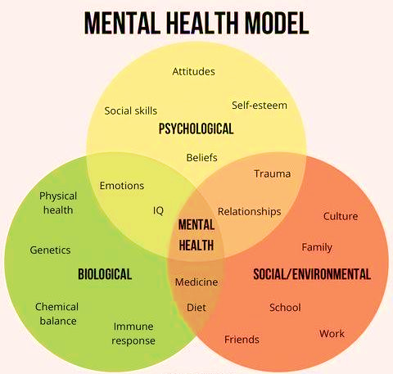

Slide 9
Why is it Critical for Judges?
Judicial work requires significant cognitive engagement, often in emotionally charged cases, from family law disputes to capital punishment trials.
Nigerian judges frequently preside over cases involving serious crimes, including corruption and terrorism, which adds substantial emotional and cognitive pressure.

Slide 10
Mental Health Challenges in the Judiciary

Slide 11
Effects of Stress on Mental Health
Depression
Fatigue
Irritability or Aggression
Burn Out
Anxiety
Feeling of Loss of Control
Sadness

Slide 12
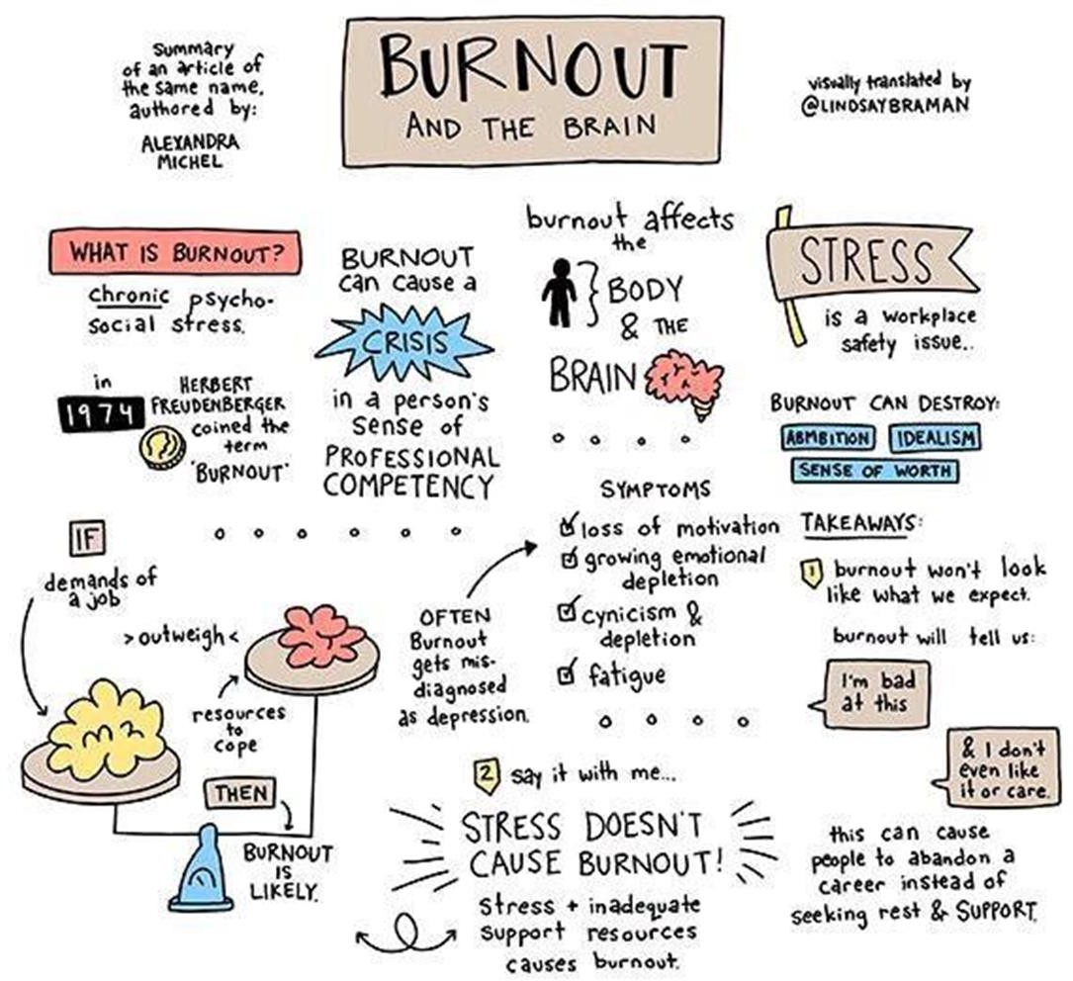

Slide 13
In the U.S., a study by the National Judicial College found that 55% of judges report feelings of burnout, primarily due to overwork and the emotional toll of their cases.

Slide 14
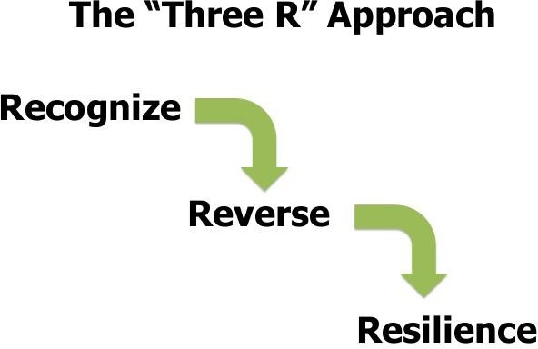
TIPS TO PREVENT BURNOUT
Dealing with burnout requires the “Three R” approach:
Recognize: Watch for the warning signs of burnout.
Reverse.: Undo the damage by seeking support and managing stress.
Resilience: Build your resilience to stress by taking care of your physical & emotional health.

Slide 15
A 2020 survey by the Nigerian Psychological Association (NPA) found that 40% of Nigerian judges reported symptoms of depression, much higher than the national average of 25%.
This can be attributed to heavy workloads and limited access to mental health support.

Slide 16
Signs and Symptoms of Mental Health Issues

Slide 17
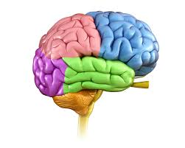
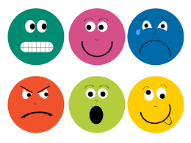
Cognitive Signs
Emotional Signs
Physical Signs
Difficulty concentrating, memory lapses, decision fatigue, and slowed thought processes.
These symptoms can severely impact a judge’s ability to deliver sound judgments.
Feelings of irritability, sadness, guilt, and withdrawal from social life. Judges working on emotionally charged cases such as domestic violence or child custody disputes may feel emotionally drained.
Chronic headaches, fatigue, digestive issues, and frequent illness can often be the body’s response to sustained mental stress.

Slide 18
Healthy Living as a Foundation for Mental Wellness

Slide 19
Physical Exercise
.
A study showed that regular physical activity professionals had a 40% lower risk of developing stress-related conditions.

Slide 20
Nutrition
A survey by the Nigerian Association of Dietitians (2021) found that professionals who maintain a balanced diet showed better focus and higher productivity.

Slide 21
Sleep
The Nigerian Institute of Social and Economic Research (NISER) found that 70% of judges reported sleep issues, which affected their performance in court and their emotional well-being.

Slide 22
Mental Health Strategies for Judges

Slide 23
Mindfulness and Meditation:
In Australia, mindfulness programs tailored to judges have been shown to reduce stress by 30% within the first six months of practice.
A pilot program initiated by the Nigerian Bar Association in 2020, which introduced mindfulness practices to judges in Lagos, reported a 25% reduction in stress-related symptoms.

Slide 24
Work Life Balance:
Establishing clear boundaries between professional and personal life is crucial to preventing burnout.

Slide 25
Local Insight
The Nigerian Judicial Council has advocated for reforms to reduce caseloads and encourage judges to take regular breaks to maintain mental health.

Slide 26
Counseling and Support:
The Nigerian Psychological Association’s 2020 report revealed that only 15% of judges in Nigeria sought counseling despite 40% showing signs of depression.
There is a need to normalize mental health support within the judiciary

Slide 27
The Importance of Institutional Support

Slide 28
Wellness Programs:
Courts can implement wellness programs, providing judges with access to fitness activities, mental health seminars, and peer support groups.
Data from the U.S.: In California, wellness programs for judicial officers reduced reported stress by 35% over two years.

Slide 29
Caseload Management:
A structured approach to managing case backlogs can reduce the stress from overwhelming caseloads.
Data from Nigeria: The Nigerian Judiciary has seen success in Lagos state courts where caseload management reforms led to a 20% reduction in judge burnout in 2021.

Slide 30
Global Perspective:
Comparing Mental Health in Judiciary Systems

Slide 31
United States:
Judges in the U.S. have access to various mental health resources through the National Judicial College, including stress management workshops, peer support, and online resources.
This has improved job satisfaction among judicial officers.

Slide 32
South Africa:
South Africa’s judiciary has integrated wellness days and mental health checks for judges, with positive outcomes.
Judges reported fewer symptoms of depression and anxiety after participating in these programs.

Slide 33
Nigeria
While Nigeria is making strides in judicial wellness, judges still need more structured mental health support.
The Nigerian Bar Association’s mental health initiatives in 2021 represent a step in the right direction, but more consistent support is necessary.

Slide 34
Creating a Mental Health Action Plan

Slide 35
Promote Mental Health Awareness
Provide Stress Management, Resilience Building and Mindfulness Technique Training
Peer Support Networks
Access to Professional Help

Slide 36
Key Takeaways:
Mental health is as essential as physical health for judges to maintain clarity and make sound decisions.
By implementing healthy living habits and mental health strategies, Nigerian judges can protect their well-being and perform their duties effectively.

Slide 37
Final Thought:
Institutions play a crucial role in providing the necessary support systems, from caseload management to mental health resources, to ensure that judges thrive both in and out of court.

Slide 38
References
WHO definition of mental health.
Nigerian Psychological Association (NPA), 2020 survey.
Nigerian Bar Association (NBA), 2021 wellness report.
Nigerian Institute of Social and Economic Research (NISER), 2020 study.
Nigerian Medical Association (NMA), 2020 data.
National Judicial College, U.S., 2020 report.
Nigerian Association of Dietitians, 2021 report.
California Judicial Wellness Program, U.S., 2020

Slide 39
THANK YOU
For listening to this presentation
DR. CHARLES CUDJOE
+234 802 3095411
drcudjoe@gmail.com

