Slide 1
Managing Remote Access and Video Links for Victims and Witnesses in Judicial Procedings
National Judicial Institute, Abuja
Digital Courtrooms:
FOLORUNSO AGBEJA
Assistant Director (ICT)
Information Technology Unit
Supreme Court Of Nigeria

Slide 2
INTRODUCTION
Our world is no longer restricted to physical boundaries, thanks to the advent of technological innovations that has revolutionize the ways we connect all over. In real world there is limitation of location but in virtual world you can connect to anyone, anywhere anytime provided you are enabled technologically.
Courtrooms in the time past were limited to a defined geographical location where the judge, litigants, legal representatives, witnesses, victims and public must converge for all judicial proceedings. The advent of video conferencing technology had made a significant impact in court proceedings by breaking these physical barriers. Technology is now enabling “virtual court” where physical location is no longer a deterrent to effective administration of justice.
Embracing modern concept of “borderless” courtroom means there will be less geographical constraints in the conduct of cases, valuable time and resources thereby saved. These technological innovations however have their associated vulnerabilities.
1

Slide 3
THE DIGITAL COURTROOM
Digital Courtroom is a system where court proceedings are seamlessly carried out with the presence of all legally authorized officials either physically or virtually through an enabling technology . Oxford Learners Dictionary defines “Virtual” as “not physically existing” but made by software to appear to do so
According to Kemi Pinheiro, SAN.,FCIArb., FIoD “No reference to a room, building or place designated as court in the constitution.”. Therefore, a digital court is not an alternative court or replacement for a physical court. It is a fully constituted court in which all legal component are available.
Digital Court uses video conferencing to facilitate access to justice, making legal proceedings more flexible and less costly with the use of different hardware tools and software. The judges, lawyers, court staff, litigants, witnesses, victims and the public can use facilities like video conferencing, e-filing, case management system in order to collaborate toward effective delivery of justice.
2

Slide 4
LEGAL FRAMEWORK FOR REMOTE ACCESS
Remote Witnessing and Virtual Hearing was a concern legal experts who argued that such courts can become a threat to the constitutionality for some of Court Proceedings and more importantly the Rule of law. The constitutionality of virtual court hearing was tested by some state Attorneys General at the Supreme Court of Nigeria during the wake of the practice in Nigeria as a result of the restrictions on physical meetings caused by the Covid 19 pandemic.
These are the cases of Attorney General of Lagos State v Attorney General of the Federation & the National Assembly (17) and Attorney General of Ekiti State v Attorney General of the Federation & 2 Ors. (18). The Supreme Court however struck out the case and held that “as of today, virtual sitting is not unconstitutional.“
In NAB LTD V. BARRI ENG. NIG. LTD., Honorable Justice Belgore JSC reasoned thus: "Hearing in public entails a situation where the public is not barred.” Remote witnessing and evidence is open to the public through the use of video conferencing facilities.
3

Slide 5
CONDUCTING HYBRID COURT SESSIONS
In Hybrid Court Session, the primary participants attend the court proceedings in person while others connect to the hearing virtually. This option is particularly useful for complex litigation or international arbitration hearings where there are a number of geographically dispersed witnesses.
Typically, both hybrid and remote participation is facilitated by virtual conferencing software. Hybrid hearings can reduce travel costs and enable access for extended litigation teams, interested parties, and general public.
Challenges Specific to Hybrid Court Sessions
Inability to clearly see and hear those participating remotely
Most Traditional courtrooms are not designed for hybrid hearings or remote access
Lack of required technology or need for improved technology support
Reverberating feedback from remote participants
4

Slide 6
DIGITAL COURT INFRASTRUCTURE REQUIREMENTS
For effective digital court, the court must implement the following procedures
Determine Court Video Conferencing hosting platform
Obtaining Licensed Video Conferencing Client Application
Determine video conferencing hosting architecture
A single desktop with high broadband internet access
A network infrastructure that support multiple workstations
High Resolution Camera or inbuilt webcam on laptop
High Resolution LED Display Unit
High Broadband Internet
5

Slide 7
REMOTE ACCESS AND VIDEO TOOLS
Video Conferencing Tools used in courts
Microsoft Teams:
Google Meet:
6

Slide 8
REMOTE APPEARANCE OF VICTIMS AND WITNESSES
In the last few years, growing case volumes, transport logistics, security breaches and costs, coupled with tightening resource constraints, have prompted courts to seek cost-saving and efficient technologies that facilitate the administration of justice.
Video Conferencing solutions are nowadays used in courts to facilitate the remote appearance and presentation of evidence by various court parties, including witnesses, victims, defendants, and outside experts. During criminal trial proceedings, video conference solutions enables the remote appearance of witnesses and victims sometimes due to various reasons bothering on security concerns, cross border logistics, disabilities and safety of victims.
However, this noble innovation also comes with its own challenges that could affect effective conduct of judicial proceedings. There is therefore the need to understand the challenges posed by the use of Digital Court and manage them to achieve efficiency.
7

Slide 9
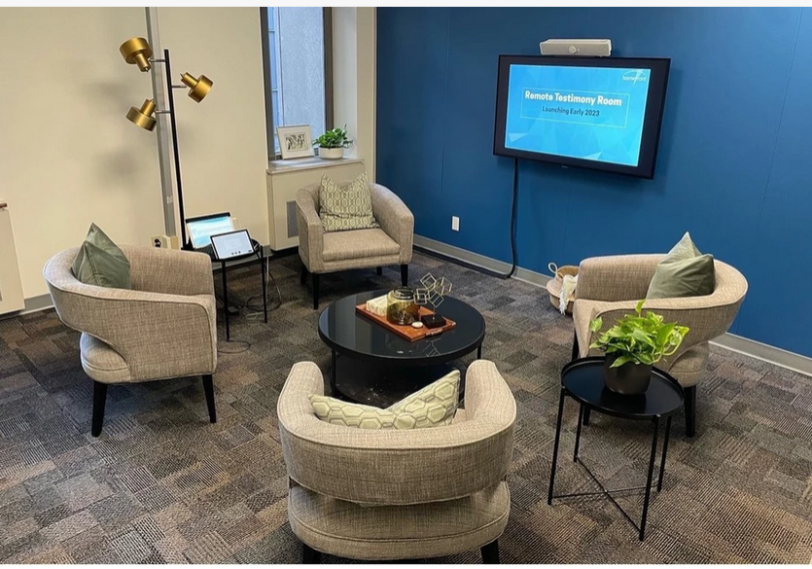
REMOTE WITNESS ROOM
Some Courts and Tribunals have Remote Witness Rooms for complainants, victims and witnesses to give their evidence remotely rather than in the courtroom. Vulnerable persons, children, victims, complainants and sexual offence witnesses in prescribed sexual offence proceedings are entitled to give their evidence remotely by means of closed-circuit television facilities or other technology that enables communication between that place and the courtroom, if they choose to do so. Such people will need to apply to the court and they will be directed to a nearby or convenient facility to them
8

Slide 10
FOUR PRINCIPLES TO SECURE VIDEO CONFERENCING
1. Connect Securely
Risk:
The initial settings for home Wi-Fi networks and many video conferencing tools are not secure by default, which—if not changed—can allow malicious actors to compromise sensitive data
Mitigation:
Change default passwords for your router and Wi-Fi network. Check that you are using Wi-Fi encrypted with WPA2 or WPA3. Verify your video conferencing security settings and use encrypted video conferencing tools whenever possible.
Actionable Tips:
Here are some simple actionable tips for connecting securely at home.
✓ Change default password to strong, complex passwords for your router and Wi-Fi network. ✓ Choose a generic name for your Wi-Fi network to help mask who the network belongs to, or its equipment manufacturer.✓ Ensure your router is configured to use WPA2 or WPA3 wireless encryption standard at the minimum, and that legacy protocols such as WEP and WPA are disabled.
9

Slide 11
FOUR PRINCIPLES TO SECURE VIDEO CONFERENCING
2. Control Access
Risk:
Uncontrolled access to conversations may result in disruption or compromise of your conversations, and exposure of sensitive information.
Mitigation:
Check your tool’s security and privacy settings. Enable features that allow you to control who can access your video chats and conference calls. When sharing invitations to calls, ensure that you are only inviting the intended attendees.
Actionable Tips:
✓ Require an access code or password to enter the event. Try not to repeat codes or passwords.✓ Manage policies to ensure only required attendees or desired group can attend. Be cautious of widely disseminating invitations.✓ Enable “waiting room” features to see and vet attendees attempting to access your event before granting access.✓ Lock the event once all intended attendees have joined.✓ Ensure that you can manually admit and remove attendees (and know how to expeditiously remove unwanted attendees) if opening the event to the public. Be mindful of how (and to whom) you disseminate invitation links.
10

Slide 12
FOUR PRINCIPLES TO SECURE VIDEO CONFERENCING
3. Manage File, Screen /sharing and Recording
Risk:
Mismanaged file sharing, screen sharing, and meeting recording can result in unauthorized access to sensitive information. Uncontrolled file sharing can inadvertently lead to users executing and clicking malicious files and links, which could, in turn, lead to system compromise
Mitigation:
Disable or limit screen and file sharing to ensure only trusted sources have the capability to share. Users should be aware of sharing individual applications versus full screens.
Actionable Tips:
Toggle settings to limit the types of files that can be shared (e.g., not allowing .exe files).
✓ When recording meetings, make sure participants are aware and that the meeting owner knows how to access and secure the recording.
✓ Consider sensitivity of data before exposing it via screen share or uploading it during video conferences.
11

Slide 13
FOUR PRINCIPLES TO SECURE VIDEO CONFERENCING
3. Update to Latest Version of Applications
Risk:
Outdated or unpatched video conference applications can expose security flaws for hackers to exploit, resulting in a disruption of meeting privacy and potential loss of information.
Mitigation:
Ensure all video conferencing tools, on desktops and mobile devices, are updated to the latest versions. Enable or opt-in to automatic update features, or else establish routine updates (e.g., once weekly) to check for new versions and patch security vulnerabilities.
Actionable Tips:
✓Enable automatic updates to keep software up to date.
✓ Develop and follow a patch management policy across the organization that requires frequent and continual application patching.
✓ Use patch management software to handle and track patching for your organization.
12

Slide 14
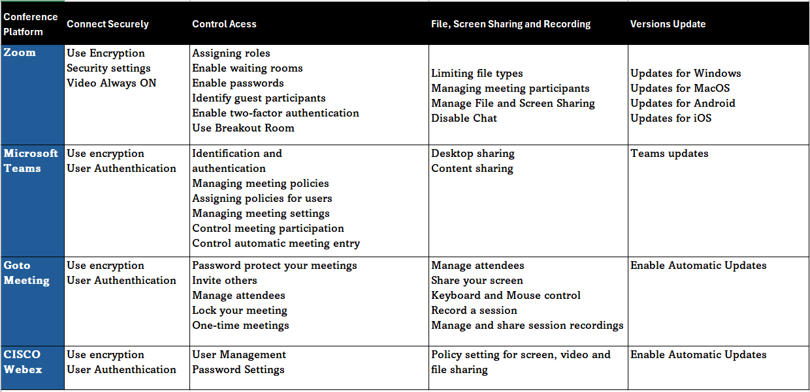
SECURITY SETTING OF COMMON VIDEO CONFERENCING TOOLS
13

Slide 15
MANAGING REMOTE ACCESS AND VIDEO LINKS
Managing remote access and video links for Digital Court requires the following
Secure your devices and network infrastructure with strong authentication
Constantly apply security fixes to your devices and conferencing software
Ensure that client uses updated version of conferencing software
Master your conferencing application system settings and apply necessary security privileges and controls
Ensure no access to participants without the host of the conferencing solution
Always have the participants video turned on
Avoid usage of ambiguous names or device names, each user clearly identified
Do not use static meeting id, the link must be unique for all sessions
Use Password / Passcode for all sessions
14

Slide 16
MANAGING REMOTE ACCESS AND VIDEO LINKS
Managing remote access and video (continued….)
Put participants in waiting room first
Mute Participants microphone on Entry
Disable Remote desktop control within conferencing solution
Disable Chat feature of the conferencing solution
Manage File and video Sharing – Users must request permission
Disable Screen Annotations by participants
Understand the use of BREAKOUT ROOM functionality (ZOOM)
Only the host should record the meeting
All Sessions should be ended properly and appropriately
Enable end-to-end encryption, these features are not always enabled by default
15

Slide 17
CONFIDENTIALITY, PRIVACY AND SECURITY
Witnesses and victims must be made aware that the proceeding is live and courtroom decorum rules apply. No one is to record the proceeding without the Court’s permission.
The location of victims and witnesses in digital courtroom may also present security and privacy concerns that courts must anticipate. Some courts require witnesses / victims to swear under oath that no one else is present or listening and/or use their device’s camera to pan around the room to demonstrate that no one else is present.
Where the witness decides to use their own devices, it is their responsibility to ensure that they have the necessary technology to participate in the remote hearing.
Digital court has much wider audience than when in the physical courtroom. Courts must be particularly attentive to victims and witnesses' submission of evidence to prevent the unintentional submission of information that should not be made public.
16

Slide 18
CHALLENGES OF REMOTE WITNESSING
Lack of Basic Technological Infrastructure
Lack of Knowledge of Virtual Hearing by participants.
Hacking and Intrusion by unauthorized participants
Slow and erratic Internet bandwidth
Inadequate laws to regulate remote witnessing
Unexpected disconnection of remote participants with valid reasons
Incompatible for those with hearing and visual disabilities
Screen fatigue can be experienced by those with some health issues
Difficulty in privacy of discussion between the counsel and their witnesses or victims
…………It is necessary to look for solutions that mitigate these challenges.
17

Slide 19
BENEFITS OF REMOTE WITNESSING
Convenience and Accessibility: The courts’ use of virtual hearings has improved some individuals’ access to the justice system. Witnesses and Victims can attend a proceeding from any location.
Cost Saving - Remote Witnessing will reduce the cost and time associated with travel and will improve the court experience for those who have mobility limitations, work or dependent care obligations that make it difficult to
Flexible Scheduling: Remote witnessing have allowed for more flexibility and reduction of unused resources when it comes to judicial scheduling. A witness can actively participate in a court session at a short notice provided he is available online.
Increased Access for public: Virtual access has allowed courts to accommodate much higher numbers of public participants than the physical constraints of a courtroom may permit
18

Slide 20
CONCLUSION
The digital age has revolutionized the way the society communicates and conduct business, and judiciary are not excepted. The law is dynamic and as such needs to grow to meet up with the global trend. The judiciary must leverage technologies that enabled remote victim appearance and remote witnessing to enhance access to speedy dispensation of justice.
However, the use of the technology in the courtroom must align with the rules and principles guiding judicial proceedings such that all actions taken physically and remotely in the process do not render the entire process null and void and of no effect.
With appropriate use of remote access tools to our courtrooms there will be greater efficiency, cost savings, quick dispensation of justice and protection of vulnerable victims and witnesses in judicial proceedings
19

Slide 21
THANK
YOU!
11

Slide 22
REFERENCES
Camille Gourdet, et al Court Appearances in Criminal Proceedings Through Telepresence Identifying Research and Practice Needs to Preserve
Fairness While Leveraging New Technology
https://www.rand.org/content/dam/rand/pubs/research_reports/RR3200/RR3222/RAND_RR3222.pdf Last Accessed on July 19, 2024.
https://www.courts.act.gov.au/magistrates/coming-to-court/witnesses/forms
Kemi Pinheiro, SAN.,FCIArb., FIoD. THE CONSTITUTIONALITY OF VIRTUAL OR REMOTE COURT PROCEEDINGS IN NIGERIA. https://nwlronline.com/uploads/Mr_Kemi_Pinheiro_SAN.pdf Last Accessed on July 19, 2024.
Moses Ogorugba Omozue, Avwerosuo Oghenedoro Developing a Legal Framework for Virtual Court Hearing in Nigeria Brown Etareri Umukoro*,
Olubukola Olugasa, Abimbola Davies: Remote Court Proceedings in Nigeria: Justice Online or Justice on the Line. https://iacajournal.org/articles/10.36745/ijca.448 (Use for reference) Last Accessed on July 19, 2024.
US Department of Homeland Security - GUIDANCE FOR SECURING VIDEO CONFERENCING - CISA PUBLICATION
VIRTUAL HEARINGS: OPERATIONAL CONSIDERATIONS – BENEFITS AND CHALLENGES - Action committee on modernizing court operations https://www.fja.gc.ca/COVID-19/Virtual-Hearings-Operational-Considerations-Audiences-Virtuelles-Enjeux-Operationnels-eng.html. Last Accessed on July 19, 2024.
11

