Slide 1
BUDGET PREPARATION AND
RESOURCE MANAGEMENT
BY NANA FATIMA MEDE (MRS)

Slide 2
TABLE OF CONTENTS
01. Introduction
02. Objectives
Understanding Judicial Financial Needs
Budget Preparation
Process
03.
04.
Legal and Policy
Framework
05.
Current State of Nigeria’s Budget Process
06.
07. Best Practices
08. Conclusion

Slide 3
INTRODUCTION
The Judiciary is the third arm of government after the Executive and Legislature. It plays a critical role in terms of decision making. The Nigerian judicial system is essential for maintaining a fair and just society, supporting democratic governance, and ensuring that the rule of law is upheld across the country.
The Nigerian judicial system faces numerous challenges, including inadequate funding, infrastructure deficits, and inefficient resource allocation. Effective budget preparation and resource management are crucial for addressing these challenges and enhancing judicial efficiency.

Slide 4
INTRODUCTION CONT’D
The budget, in whatever context it is defined, is a plan.
A plan expressed in a document that gives information about the objectives and policy measures a country intends to pursue during a specified period of time.
It also indicates the funding requirements of the chosen policy measures and projects, the funding sources and the allocation of funds to the projects.
Budgeting is key to the implementation of identified national development goals.
Budget is basically a formal statement of the financial resources set aside for carrying out specific activities in a given period of time usually a year.
The budget sets forth priorities as well as levels of spending, ways of financing the spending, ways of financing the spending and a plan for managing the funds.
Thus the budget is the most single important fiscal tool available that the government/judiciary uses as a yardstick to raise and allocate funds and measure its performance in a given fiscal year.

Slide 5
OBJECTIVES
To enhance efficiency, effectiveness, transparency and accountability in the Judiciary through the budgeting process.
To effectively streamline and efficiently allocate resources to enhance performance and smooth running of the Judicial system and administration of justice
To ensure that there are good internal measures and control in the management of finances of the Judiciary
To enhance Monitoring and Evaluation of actual results with estimates

Slide 6
OBJECTIVES CONT’D
To briefly refresh the knowledge of the participants on the concepts, principles and practices of budgeting.
Discuss Nigeria Nigeria’s experience in budgeting.
Discuss about the various laws that guide budgeting in Nigeria.
To highlight cash flow shortages and financial requirements.

Slide 7
UNDERSTANDING THE JUDICIAL FINANCIAL NEEDS
The judiciary plays a vital role in our society, and to do so effectively, adequate resources are required in order to:
Expedite the dispensation of justice effectively and processing of court cases
Analyze data
Maintain and upgrade court buildings especially in rural areas
Capacity building of judges and court staff.etc

Slide 8
BUDGET PREPARATION
PROCESS

Slide 9
2024 NATIONAL BUDGET
REVENUE
Share of
non-oil taxes
Share of oil
revenue
3.52tn
7.68tn
Total Revenue
18.32tn
Independent
Revenue
Revenue
from GOE’s
1.91tn
4.07bn
Others
Share of Minerals
and mining
DEFICIT
9.18tn
1.13tn
4.55tn
EXPENDITURE
Statutory
Transfer
Recurrent
(Non - Debt)
1.37tn
Total Expenditure
9.92tn
27.50tn
Capital
Expenditure
Debt
Service
7.72tn
8.25tn
Sinking
Fund
243.66bn
Source: Budget Office of the Federation

Slide 10
2024 APPROVED BUDGET BREAKDOWN
The Judiciary
Universal Basic Education Commision
N341.636
Billion
N263.044
Billion
National Human Rights Commision
Niger Delta Development
Commission
N5
Billion
N338.925
Billion
Source: Budget Office of the Federation

Slide 11
2024 APPROVED BUDGET BREAKDOWN (Continuation )
Basic Health Care provision fund
North East Development
commision
N131.522
Billion
N131.836
Billion
National Agency for Science and Engineering Infrastructure
Public Complaint Commission
N131.522
Billion
N14.460
Billion
Source: Budget Office of the Federation

Slide 12
BUDGETING
While budget is containing the details of the estimates of revenue and expenditures including the policy measure to actualize it,budgeting is the act or process of producing the budget.
Budget is a document that clearly identifies the sources and allocation of funds for services, programmes and projects within a fiscal year.
LAWS GUIDING BUDGET PREPARATION IN NIGERIA
The 1999 Constitution of the Federal Republic of Nigeria as amended
The Finance(Control and Management) Act, 1958
Fiscal Responsibility Act. 2007
Public Procurement Act, 2007
The Finance Acts
Debt Management Act. 2005
Allocation of Revenue Act, 1982
Public Accounts Committee, Act;
Budget Call Circulars; and
Annual Appropriation Acts

Slide 13
BENEFITS OF BUDGETING
Helps in planning orientation, funding planning
Helps government to be focused on their activities
Helps to give control over government fund
Helps in promoting proactivity in government business
Helps to promote transparency and accountability
Helps to provide basis for reviews and monitoring

Slide 14
BENEFITS OF BUDGETING CONT’D
Helps to promote organized spending and savings
Gives room for participation of other stakeholders
Helps in communicating with the citizens and other stakeholders
Helps in giving direction for the economy
Provides data for future planning

Slide 15
THE BUDGET CYCLE
A budget cycle is the life of a budget for a fiscal year, from creation or preparation, to evaluation
FORMULATION
• Clarifying the roles and duties of all those involved in budget process
• Communicating guidelines for budget preparation
• Reviewing and general coordination of processes to ensure consistency.
APPROVAL
The responsibility of budget approval and appropriation lies with the parliament upon submission by the executive, after a rigorous engagement with the citizenry
After reviewing the main assumptions underpinning the budget (such as interest rates, inflation rates, financial risks, exchange rates, crude oil benchmark price, contingent liabilities) and further consultation with other stakeholders, will pass the Appropriation Bill to the executive for ascent by the president and subsequent execution
EXECUTION (IMPLEMENTATION)
Implementing the budget in full compliance with the Appropriation Act, while the members of parliament and non state actors provide oversight to ensure compliance.

Slide 16
THE BUDGET CYCLE...2
MONITORING AND EVALUATION
This implies continuous monitoring of the implementation of the budget or Budget performance.
Evaluation and impact assessment should be carried out at the end of the fiscal year to compare and confirm that Execution aligns with the Budget. This stage also highlights uncompleted projects that can be rolled over to the next budget cycle. The Legislative oversight is highly recommended at this stage.

Slide 17
BUDGET PREPARATION...1
1
2
3
Needs assessment:
Conduct a comprehensive needs assessment to identify priorities and allocate resources accordingly.
Identify the judiciary's priorities, goals, and objectives. This involves assessing the current state of the judiciary, including infrastructure, personnel, and technology.
Zero-based budgeting:
Adopt a zero-based budgeting approach, where every expense must be justified and approved.
Start from a "zero base" and justify every expense. This approach ensures that every allocation is necessary and supports the judiciary's goals.
Stakeholder engagement:
Engage with stakeholders, including judges, court administrators, and lawyers, to ensure inclusive budgeting.
Involve judges, court administrators, lawyers, and other stakeholders in the budgeting process. This ensures that everyone's needs are considered and that the budget is realistic.

Slide 18
BUDGET PREPARATION...2
4
5
Revenue Projection
Estimate revenue from various sources, such as government allocations, court fees, and grants.
Zero-based budgeting:
Allocate resources to different areas, such as:
Personnel (salaries, training, benefits)
Infrastructure (maintenance, upgrades, new buildings)
Technology (case management systems, digitalization)
Operations (utilities, supplies, services)

Slide 19
LEGAL AND POLICY FRAMEWORK

Slide 20
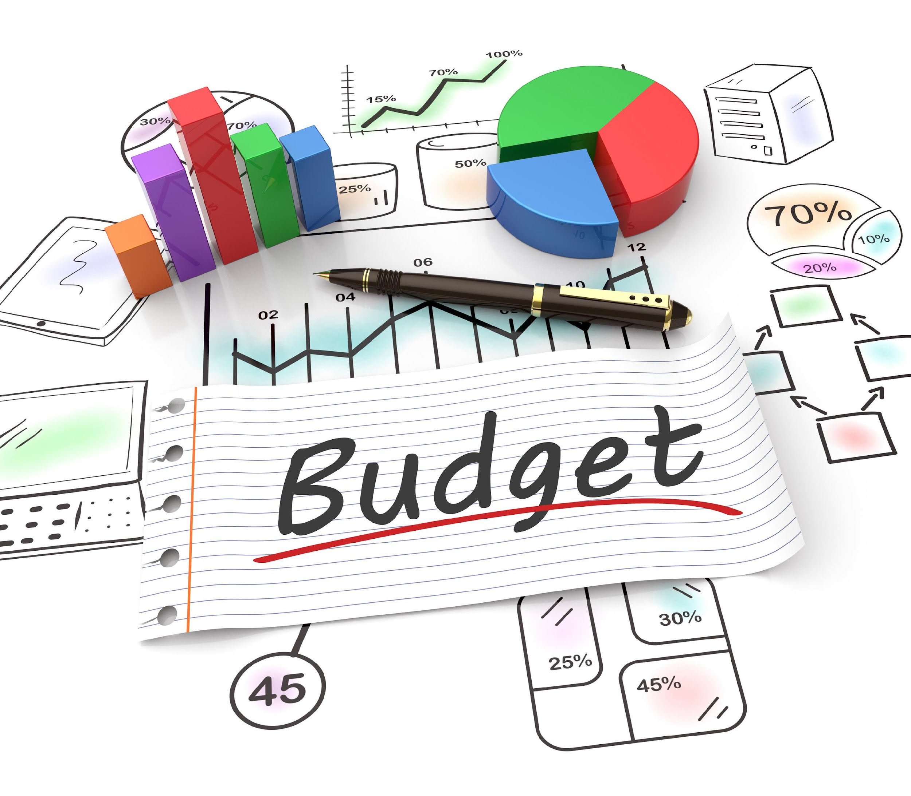
LEGAL AND POLICY FRAMEWORK IN NIGERIA
These legal and policy framework aim to create a more robust, transparent, and efficient system for judicial budgeting and resource management. Implementation would require collaboration between the judiciary, legislature, and executive, as well as engagement with civil society and international partners.

Slide 21
Legal and Policy Framework
Constitutional Provisions for Judicial Financial Autonomy
Policy Recommendations for Improved Resource Management
Legislative Reforms to Support Effective Budgeting
The Nigerian Constitution provides a foundation for judicial financial autonomy, primarily through the following provisions:
To enhance resource management within the legal and policy framework, the following recommendations are proposed
Legislative efforts in place to enhance
judicial budgeting:
Future legislative reforms should focus on
Section 81(3) of the 1999 Constitution (as amended) stipulates that funds for the judiciary should be paid directly to the National Judicial Council for disbursement to the heads of courts.
The Constitution (Fourth Alteration, No. 4) Act 2017 further strengthened this by granting financial autonomy to state judiciaries and legislatures.
Develop a Comprehensive Judicial Sector Policy
Implement a Judicial Financial Management Act
Create a Judicial Service Delivery Charter
Establish an Independent Judicial Budget Office
Develop a Technology Adoption Policy
Implement a Judicial Human Resource Management Policy
Introduce a Judicial Infrastructure Development Plan
Establish a Judicial Procurement Policy
Develop a Judicial Revenue Generation Policy
Create a Judicial Audit and Compliance Policy
The Executive Order No. 10 of 2020: Aimed at enforcing financial autonomy for state legislatures and judiciaries. However, its implementation has faced significant challenges.
The Administration of Criminal Justice Act (ACJA) 2015: While primarily focused on criminal justice reform, it includes provisions that impact judicial resource allocation and management.
Proposed Judicial Financial Autonomy Bill: There have been calls for a comprehensive bill to address the specifics of judicial financial autonomy and budgeting processes.
Clarifying the mechanisms for direct funding of the judiciary
Establishing clear guidelines for budget preparation and execution
Providing legal backing for performance-based budgeting in the judiciary

Slide 22
RESOURCE MANAGEMENT
01.
02.
Human resources:
Optimize human resource allocation, ensuring the right personnel are in the right positions.This includes:
- Staff training and development
- Performance management
- Succession planning
Infrastructure management:
Implement effective maintenance and upgrade strategies for court infrastructure.
Effectively maintain and upgrade court infrastructure, including:
- Buildings and facilities
- Equipment and furniture
- Utilities and services
03.
Technology integration: Leverage technology to enhance court operations, case management, and public access. including:
- Case management systems
- Digitalization of records
- Online platforms for filing
and accessing documents
04.
Financial Management
Ensure transparent and accountable financial management, including:
- Budget monitoring and control
- Expenditure tracking
- Auditing and reporting

Slide 23
IMPROVING RESOURCE ALLOCATION AND EFFICIENT BUDGET IMPLEMENTATION
NASS to ensure that projects included in the budget emanates only from the Executive arm and as submitted by NJC
There should be efficient and effective monitoring and evaluation mechanism put in palce by NJC
There should be effective control of expenditures at each stages of the budget or expenditure cycle.
NJC to reinforce expenditure control mechanism for efficient and effective budget implementation by the Courts.
Ensuring conformity in budget execution with the policies stated in the approved budget
There should be predictability and timeliness in the release of funds to allow for orderly planning and implementation of the budget
Granting of some flexibility to the lower level courts rather than central control of the total implementation of the budget

Slide 24
CURRENT STATE OF NIGERIA’S
Budget Process

Slide 25
CHALLENGES WITH BUDGETING PROCESSES
The Nigerian budget process like any other country across the globe is characterized by some challenges.
The over bloated nature of the budget
Poor monitoring and
evaluation techniques
Partial funding of projects across the country
Increasing risk of neglect on old projects as new projects are being introduce
Poorly monitored through the various stages of completion
Some projects are approved without detailed costing and engineering design.
Weak reporting culture of the Ministries Departments and Agencies.
Their reports are not well detailed, as various stages of implementation are not stated.
Unplanned size of the
recurrent expenditure
The nature of the budget process often poses a challenge.
Increases in the wage bill and in allocation to certain MDAs have resulted in bloated budget

Slide 26
CHALLENGES OF BUDGET IMPLEMENTATION IN NIGERIA
1
3
4
2
Lack of wider consultation with experts in the Private Sector, Civil Society and other interest groups in the budgetary process to accurately forecast economic variables
Extreme uncertainty concerning available resources
Late Budget preparation
and Approval
Unrealistic estimates
5
7
8
6
Extra budgetary expenditure outside the Appropriation Act, due to Political and unforeseen occurrences/ disasters.
Lack of institutional capacity for effective monitoring
Significant discrepancy between actual and reported expenditure for certain activities
Lack of transparency and accountability

Slide 27
CHALLENGES OF BUDGET IMPLEMENTATION IN NIGERIA
10
9
Lack of synergy amongst MDAs and the desire to work in silos, leading to duplication of efforts and waste of scarce resources
Lack of Institutionalized evaluation of Budget performance and impact assessment

Slide 28
IMPACT OF BUDGETARY CONSTRAINTS ON JUDICIAL PERFORMANCE
Budgetary constraints have a significant and multifaceted impact on judicial performance in Nigeria. They affect not only the day-to-day operations of courts but also the long-term development and credibility of the entire legal system. Addressing these constraints is crucial for strengthening Nigeria’s legal and judicial system.
Case Backlogs and Delays
Infrastructure and Technology Limitations
Reduced Access to Justice
Insufficient funding leads to inadequate staffing and resources, resulting in slower case processing.
Overburdened courts struggle to handle caseloads efficiently, leading to prolonged trial periods.
Delays in justice erode public trust and can lead to the denial of timely justice.
Limited resources may result in fewer courts, particularly in rural areas.
Financial constraints can limit legal aid services, disadvantaging economically vulnerable citizens.
Inadequate funding for mobile courts or alternative dispute resolution mechanisms restricts access to justice.
Lack of funds for modernization leaves many courts with outdated facilities and equipment.
Absence of digital case management systems and e-filing capabilities hampers efficiency.
Poor working conditions can negatively impact staff morale and productivity.

Slide 29
IMPACT OF BUDGETARY CONSTRAINTS ON JUDICIAL PERFORMANCE...2
Training and Capacity Building Shortfalls
Vulnerability to Corruption
Quality of Judgments
Budget limitations often lead to reduced opportunities for continuing education and professional development for judges and court staff.
This can result in a judiciary that struggles to keep pace with evolving legal issues and technological advancements.
Inadequate compensation for judicial officers may increase susceptibility to bribery and corruption.
Lack of resources for oversight and anti-corruption measures can foster an environment where unethical practices go unchecked.
Overworked and under-resourced judges may not have adequate time or resources to conduct thorough research, potentially affecting the quality of judgments.
Limited access to up-to-date legal resources and databases can impact the depth and accuracy of legal interpretations.
Independence of the Judiciary
Witness and Evidence Management
Public Perception and Confidence
- Financial dependence on the executive branch can compromise the judiciary's autonomy and impartiality.
- Inadequate funding may make the judiciary vulnerable to political pressures and interference.
Lack of funds for witness protection programs and advanced forensic capabilities can hinder the effective presentation and examination of evidence.
A poorly funded judiciary often struggles with public image issues, leading to decreased confidence in the legal system.
This can result in reduced willingness to use formal legal channels for dispute resolution.

Slide 30
IMPACT OF BUDGETARY CONSTRAINTS ON JUDICIAL PERFORMANCE...3
Staff Retention and Recruitment
Innovation and Reform Limitations
- Inadequate budgets often mean lower salaries and fewer benefits, making it difficult to attract and
retain high-quality legal professionals and support staff.
Budget constraints can stifle initiatives for judicial reform and innovation in court processes.
Limited resources may prevent the adoption of best practices observed in other jurisdictions.

Slide 31
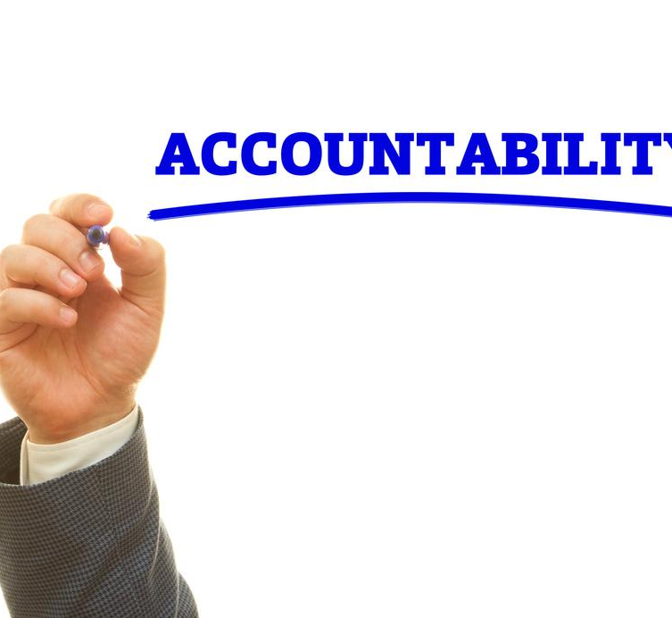
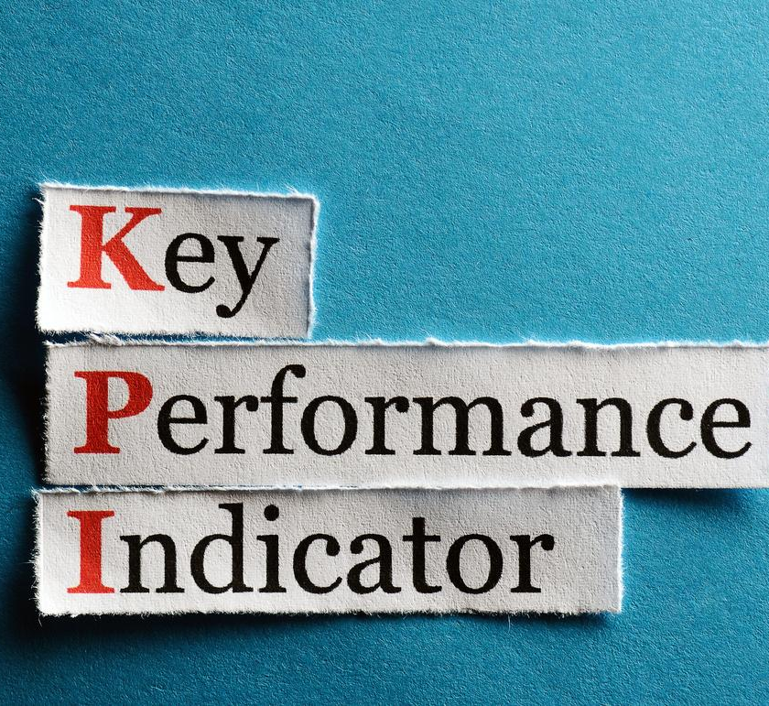
BEST PRACTICES
01.
Transparency and accountability: Ensure transparent budgeting and resource allocation processes.
02.
Performance monitoring: Establish key performance indicators (KPIs) to measure budget effectiveness.
03.
Continuous improvement: Regularly review and refine budget preparation and resource management processes.

Slide 32
CONCLUSION
The paper examined the salient features of budget planning, implementation, appraisal and monitoring in Nigeria.
It is believed that proper budget planning, transparent implementation, effective monitoring and evaluation mechanism will ensure proper budget implementation and improvement in the performance of the Courts.
Effective budget preparation and resource management are critical for enhancing judicial efficiency in Nigeria. By adopting a needs-based approach, engaging stakeholders, and optimizing resource allocation, the judiciary can improve its performance and deliver justice effective

Slide 33
THANK'S FOR
LISTENING

