Slide 1









Asset Tracing, Recovery, Confiscation and Management:
The Perspective of the Nigerian Financial Intelligence Unit
(NFIU)
A paper delivered during the Workshop for Judicial Officers on Transnational Organized Crimes and Counter-Terrorism on 22 April 2024 with the Theme "Strengthening the Trial of Transnational Organised Crime and Counter Terrorism Proceedings" on 22nd April 2024 at Andrew Otutu Obaseki Auditorium, National Judicial Institute, Abuja, FCT
By Dr. Muhammad Jiya
Associate Director, Analysis and Compliance Directorate
Vice – Chair, Information Exchange Working Group (IEWG)
Nigerian Financial Intelligence Unit (NFIU)
Egmont Group of Financial Intelligence Units (FIUs)
Asset Tracing, Recovery, Confiscation and Management - Perspective of NFIU

Slide 2

Presentation
Outline
1
Concept and Imperative of Asset Tracing, Tracking, Recovery, Confiscation and Management
Overview of existing Legal Framework/Guidelines for Asset Tracing, Tracking, Recovery, Confiscation and Management
2
3
Various Techniques, Technology and other Tools and other Tools as well as best practices for Asset Tracing, Tracking and Management
4
Nigerian Financial Intelligence Unit (NFIU) in Brief – Mandate, Core Functions and Powers
Unique methodology, concerns and approaches applied by the NFIU in combatting illicit financial flows (IFFs).
5
6
Exploring the Prospects for Synergy between the relevant Agencies for better Performance
Challenges the relevant Agencies encounter in dealing with the Assets and Recommendations that will engender more efficiency.
7

Slide 3
Concept and Imperative of Asset Tracing, Tracking,
Recovery, Confiscation and Management
Asset tracing, tracking, recovery, confiscation, and management are key components of financial investigation and legal processes aimed at identifying, seizing, and managing assets that are involved in or derived from criminal activities or other illicit practices.
These concepts are crucial in combating financial crimes such as money laundering, corruption, fraud, illicit financial flows and terrorist financing.
Effective asset tracing, tracking, recovery, confiscation, and management play a vital role in disrupting criminal networks, deterring illicit activities, and promoting the rule of law.

Slide 4
Concept and Imperative of Asset Tracing, Tracking,
Recovery, Confiscation and Management
Asset Tracing
This involves identifying and tracing the movement of assets, which could include funds, properties, or other valuable items, through various financial transactions or ownership structures. Asset tracing often requires sophisticated investigative techniques and tools to follow the trail of illicit funds or assets through complex networks and jurisdictions.
Asset Tracking
Once assets have been identified, tracking involves monitoring their movements or changes in ownership over time. This can include monitoring bank accounts, real estate transactions, or other financial activities associated with the assets in question. Advanced tracking technologies such as blockchain analysis or forensic accounting methods may be employed to monitor the flow of assets.

Slide 5
Concept and Imperative of Asset Tracing, Tracking,
Recovery, Confiscation and Management
Asset Recovery
Asset recovery refers to the process of legally seizing or reclaiming assets that have been identified as proceeds of crime or illicitly obtained. This can involve civil or criminal proceedings, depending on the jurisdiction and the nature of the assets involved. Asset recovery efforts may be pursued domestically or through international cooperation and mutual legal assistance treaties.
As outlined in the UN Convention against Corruption (UNCAC Chapter V), asset recovery refers to the process by which the proceeds of corruption are transferred abroad and repatriated to the country from which they were taken or to their rightful owners. Although relevant to corruption-related assets, this definition can also be applied to asset recovery cases in general.
A similar definition is provided in the FATF report on Best Practices on Confiscation (Recommendations 4 and 38) and a Framework for Ongoing Work on Asset Recovery, where asset recovery is defined as the return or repatriation of illicit proceeds, where those proceeds are located in foreign countries.

Slide 6
Concept and Imperative of Asset Tracing, Tracking,
Recovery, Confiscation and Management
General Process for Asset Recovery
Collecting Intelligence and Evidence and Asset Tracing
(Domestically and in Foreign Jurisdictions using MLA)
Securing the Assets
(Domestically and in Foreign Jurisdictions using MLA)
Court Process
(To obtain conviction [if possible], Confiscation, fines, damages, and/or compensation)
Enforcing Orders
(Domestically and in Foreign Jurisdictions using MLA)
Return of Assets

Slide 7
Concept and Imperative of Asset Tracing, Tracking,
Recovery, Confiscation and Management
Asset Confiscation
Confiscation involves law enforcement or regulatory authorities' legal seizure and forfeiture of assets. Confiscated assets are typically taken out of the hands of criminals and may be used to compensate victims, fund law enforcement activities, or contribute to social programs. Confiscation orders can be issued as part of criminal prosecutions or civil proceedings against individuals or entities involved in illegal activities.
According to FATF, Confiscation is the permanent deprivation of funds or other assets by a competent authority or a court (includes forfeiture, where applicable). Confiscation or forfeiture occurs through a judicial or administrative process that transfers the ownership of specified funds or other assets to the State.

Slide 8
Concept and Imperative of Asset Tracing, Tracking,
Recovery, Confiscation and Management
Asset Confiscation
Confiscation involves law enforcement or regulatory authorities' legal seizure and forfeiture of assets. Confiscated assets are typically taken out of the hands of criminals and may be used to compensate victims, fund law enforcement activities, or contribute to social programs. Confiscation orders can be issued as part of criminal prosecutions or civil proceedings against individuals or entities involved in illegal activities.
According to FATF, Confiscation is the permanent deprivation of funds or other assets by a competent authority or a court (includes forfeiture, where applicable). Confiscation or forfeiture occurs through a judicial or administrative process that transfers the ownership of specified funds or other assets to the State.
Asset Management
Once assets have been recovered or confiscated, they need to be managed effectively to preserve their value and ensure they are put to lawful use. Asset management may involve selling seized assets, repatriating funds to victims, or managing confiscated properties or financial instruments. Proper asset management is essential to prevent the dissipation or loss of recovered assets and to maximise their potential benefits.

Slide 9
Overview of existing Legal Framework/Guidelines for Asset Tracing, Tracking, Recovery, Confiscation and Management
On 12th May 2022, President Muhammadu Buhari signed into Law the Proceeds of Crime (Recovery and Management) Act, 2022 (“the Act”) in a bid to boost Nigeria’s fight against corruption, money laundering, and illicit financial flows of stolen funds. The Act contains comprehensive provisions for seizure, confiscation, forfeiture, and management of properties derived from unlawful activities and other related matters.
The Act seeks to provide an effective legal and institutional framework for the recovery and management of the proceeds of crime, a non-conviction-based procedure for the recovery of proceeds of crime, a strengthened criminal confiscation procedure, and collaboration among the relevant organizations in tracing properties reasonably suspected to be proceeds of unlawful activity.

Slide 10
Overview of existing Legal Framework/Guidelines for Asset Tracing, Tracking, Recovery, Confiscation and Management - Relevant Organisations.
EFCC
ICPC
NDLEA
NAPTIP
NAFDAC
NCS
NFIU
CCB
NPF
DSS
Armed Forces
SON
NIMASA
NIS
NPA
NIWA
NSCDC
FIRS
Others
Sections 58-67 - The Act establishes a group of diverse law enforcement and security agencies collectively known as Relevant Organisations
The Relevant Organisation is to enforce and administer the provisions of the Act.

Slide 11
Overview of existing Legal Framework/Guidelines for Asset Tracing, Tracking, Recovery, Confiscation and Management - Proceeds of Crime Management Directorate.
The Act establishes the Proceeds of Crime Management Directorate in relevant organizations (“the Directorate”).
With exclusive power to take over and assume responsibility for the proper and effective management of properties forfeited to the FGN among others.
The Directorate shall be informed of any property seized in the course of investigation within 14 days or soon thereafter for documentation. (Section 5).
Any property seized in the course of an investigation shall, subject to the specific orders of the Court, be transferred to the Directorate for its effective management within 30 days.

Slide 12
Overview of existing Legal Framework/Guidelines for Asset Tracing, Tracking, Recovery, Confiscation and Management - Overview of Proceeds of Crime (Recovery and Management) Act, 2022
PART I—Objectives and application of this Act (Section 1-2)
Objectives and Application.
PART II—Proceeds of Crime Management Directorate (Section 3-5)
Establishment and functions of the Proceeds of Crime Management Directorate in the relevant organisation., Powers of the relevant organisation, Role of the Directorate in the process of management of forfeited properties.
PART III—Relationship between the Relevant Organisation and other Entities (section 6-25)
Co-operation between relevant organisation and other entities.
PART IV—Non–conviction based recovery of the Proceeds of Crime (section 6)
Preservation order: Notice, Duration, Renewal and Disposal of property subject to preservation order. Appointment of asset manager for property subject to a preservation order. Forfeiture order: Application, Service, etc
PART V—Recovery of Cash (Section 26-32)
Seizure and detention of cash. Detention of seized cash. Interest to be paid on seized cash. Release of detained cash. Application for forfeiture of seized or detained cash. Appeals. Other owners or claimants.
PART VI—Confiscation of Proceeds Of Crime (Section 33-52)
Restraint order: Purposes , Property subject to a restraint order. Affidavit, Notice, Registration of restraint order. Setting aside a disposition contravening a restraint order, Confiscation orders: Enforcement of confiscation orders

Slide 13
Overview of existing Legal Framework/Guidelines for Asset Tracing, Tracking, Recovery, Confiscation and Management - Overview of Proceeds of Crime (Recovery and Management) Act, 2022
PART VII—Investigation, Search and Seizure (Section 53-57)
Actions detrimental to an investigation. Retention of seized property. Obstructing the execution of a search and seizure warrant.
PART VIII—Administration (Section 58-67)
Powers and duties of the relevant organisation in respect of property seized. Preserving controlled property. Rights attaching to shares. Destroying or disposing of property. Notice of proposed destruction or disposal of controlled property.
PART IX—Confiscated and Forfeited Properties Account (Section 68-72)
Establishment and Payments of the Confiscated and Forfeited Properties Account. Audit of the Confiscated and Forfeited Properties Account. Authorisation of expenditures for approved programmes of relevant organisation.
PART X—Jurisdiction (Section 73)
Jurisdiction
PART XI—General Provisions relating to Legal Proceedings (Section 74-80)
Burden of proof. Stay of proceedings. Publication of notice. Relationship with relevant laws. Pre-action notice. Restriction on execution against property of the relevant organisation. Indemnity of officers of the relevant organisation.
PART XII—Miscellaneous Provisions (Section 81 - 83)
Regulations and guidelines, Interpretation and Citation.

Slide 14
Various Techniques, Technology and other Tools, as well as best practices for Asset Tracing, Tracking, Recovery, Confiscation and Management
Legal Instruments:
Use legal instruments such as subpoenas, court orders, search warrants, and asset-freezing orders to compel individuals or entities to disclose information or surrender assets.
01
Digital Forensics:
03
02
Data Analysis and Forensic Accounting:
Employ digital forensic tools and techniques to trace digital footprints left by individuals or organisations.
Utilise data analysis tools and forensic accounting techniques to trace financial transactions and uncover hidden assets.
04
Open Source Intelligence (OSINT):
Leverage OSINT tools and methods to gather publicly available information about individuals or entities. This could involve searching online databases, social media platforms, public records, etc.

Slide 15
Various Techniques, Technology and other Tools, as well as best practices for Asset Tracing, Tracking, Recovery, Confiscation and Management
Surveillance and Investigation:
05
Conduct surveillance and investigation to gather firsthand evidence of asset ownership or unlawful activities.
Blockchain Analysis:
Asset Recovery Specialists:
06
07
Seek assistance from asset recovery specialists or firms that specialise in tracing, recovering, and managing assets.
Utilise blockchain analysis tools and techniques to trace cryptocurrency transactions and uncover hidden assets stored in digital wallets.

Slide 16
Various Techniques, Technology and other Tools, as well as best practices for Asset Tracing, Tracking, Recovery, Confiscation and Management
Documentation and Chain of Custody:
09
08
Asset Management Software:
Maintain accurate documentation and establish a clear chain of custody for recovered assets to ensure their proper management and disposal.
Implement asset management software systems to streamline the process of tracking and managing recovered assets.
10
Risk Assessment and Due Diligence:
Conduct comprehensive risk assessments and due diligence checks to assess the legitimacy of assets and identify potential risks associated with asset tracing and recovery operations.

Slide 17
Various Techniques, Technology and other Tools, as well as best practices for Asset Tracing, Tracking, Recovery, Confiscation and Management.
International Cooperation:
11
Collaborate with LEAs, regulatory bodies, and international organisations to facilitate cross-border asset tracing and recovery efforts. This may involve sharing intelligence, coordinating investigations, and pursuing legal action in multiple jurisdictions to recover assets hidden offshore or in foreign territories.
Asset tracing, tracking, recovery, confiscation, and management are crucial aspects of various fields, including Law Enforcement Agencies, financial investigation, and asset management.
Training and Capacity Building:
12
Provide training and capacity-building programs for law enforcement personnel, financial investigators, and other relevant stakeholders involved in asset tracing and recovery efforts.
By employing a combination of techniques, technologies, and best practices, stakeholders involved in asset tracing, tracking, recovery, confiscation, and management can enhance their effectiveness in identifying, seizing, and managing assets associated with illicit activities.

Slide 18
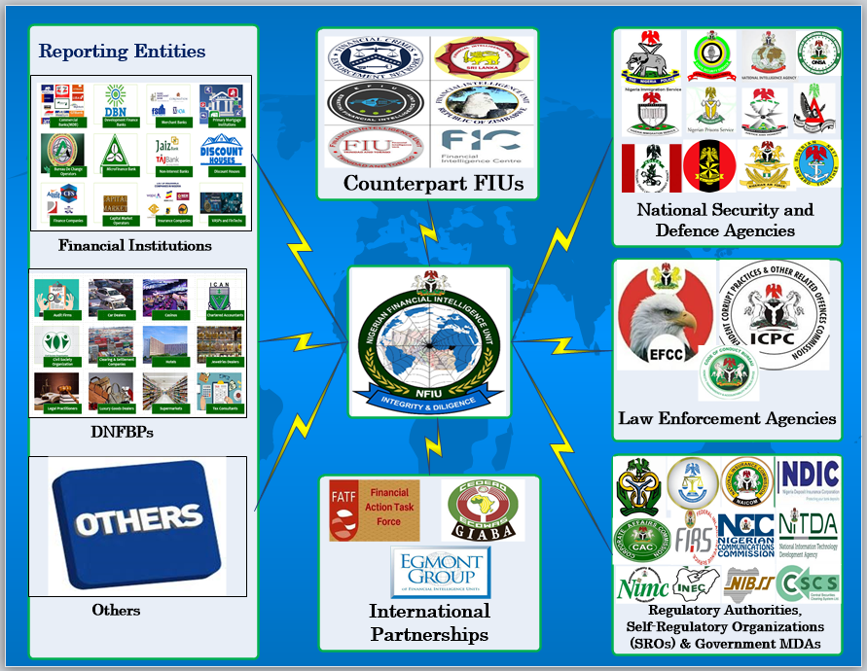
Nigerian Financial Intelligence Unit (NFIU)
Nigerian Financial Intelligence Unit (NFIU), the central body in Nigeria responsible for receiving, requesting, analysing and disseminating financial intelligence reports on money laundering, terrorist financing and other relevant information to law enforcement, security and intelligence agencies, and other relevant authorities.

Slide 19
Nigerian Financial Intelligence Unit (NFIU)
4,000
47
98.8 million
180,000
174
Over 300
Reporting Entities
Competent Authorities
CTRs/FTRs
SARs/STRs
FIUs via ESW & others
Intelligence Analysts

Slide 20
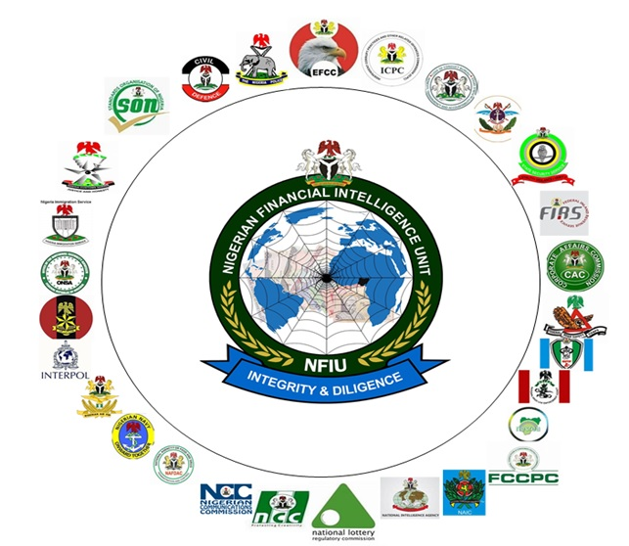




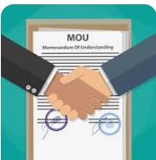
Nigerian Financial Intelligence Unit (NFIU) - Powers
Corruption,
Money Laundering
and other
Predicate Offences
1.
To collaborate with other Regulatory Authorities, LEAs, ACAs, Security Agencies, and SROs in Nigeria in combating ML, TF, PF and related activities
2.
To review AML and CFT measures on a regular basis in consultation with Regulatory authorities and other relevant stakeholders.
3.
To direct the prompt monitoring or immediate stop of financial transactions, accounts or transfer of funds in any FI, DFNBP or any other institution
4.
To request for and collect such other information as the Unit deems necessary in fulfil its functions & got Presidential Consent implement it on Databases
Arms Proliferation
and Financing of
Arms Proliferation
Terrorism and
Financing of
Terrorism
5.
Arms Proliferation
and Financing of
Arms Proliferation
To request for additional information from institutions and Reporting Entities, LEAs/ACAs and Security Agencies required to perform its function.
6.
To enter into MOU or such other arrangements as will enable it to carry out its functions effectively in Nigeria and with counterparts in other countries.

Slide 21
Nigerian Financial Intelligence Unit (NFIU)
Crime Records Information Management System (CRIMS)
Developed In-house with inputs from Stakeholders and hosted On-Premise.
Successfully deployed in 45 Agencies (LEAs, ACAs and Others) in the Country.
2,996 Intelligence Reports (IRs) on AML/CFT generated and disseminated to Agencies from Jan. 2021 to Date.

Slide 22
Egmont Group of Financial Intelligence Units
The Egmont Group is a united body of 174 Financial Intelligence Units (FIUs): FIUs are uniquely positioned to support national and international efforts to Anti-Money Laundering and Counter-Terrorist Financing.
FIUs are also trusted gateways for sharing financial information domestically and internationally per global anti-money laundering and counter-financing of terrorism (AML/CFT) standards.
The Egmont Group provides FIUs with a platform to securely exchange expertise and financial intelligence to combat money laundering, terrorist financing (ML/TF), and associated predicate offences.

Slide 23

Egmont Group of Financial Intelligence Units
Adding Value to Work of FIUs:
Egmont Group adds value to member FIUs’ work by improving stakeholders’ understanding of ML/TF risks and draws upon operational experience to inform policy considerations, including AML/CFT implementation and AML/CFT reforms. The Egmont Group is the operational arm of the international AML/CFT apparatus.
Financial Intelligence Sharing & International Cooperation:
The Egmont Group recognizes financial intelligence sharing is of paramount importance and has become the cornerstone of international efforts to counter ML/TF. FIUs around the world are obliged by international AML/CFT standards to exchange information and engage in international cooperation. As a global financial intelligence forum, the Egmont Group facilitates and prompts this exchange amongst its member FIUs.
International Standards Implementation:
The Egmont Group supports international partners’ and other stakeholders’ efforts to implement the resolutions and statements of the United Nations Security Council, Financial Action Task Force (FATF), and G20 Finance Ministers.

Slide 24
Egmont Group of Financial Intelligence Units
Egmont Secure Web (ESW)
The ESW is an electronic communication system that allows encrypted sharing among members of emails and financial intelligence, as well as other information of interest to members and to the functioning of the Egmont Group.
The ESW is critical to the effective functioning of the Egmont Group and therefore the Head of FIU (HoFIU) provide the mandate for the ESW, and approve and monitor its governance structure and policies.
The purpose of the Egmont Secure Web (ESW):
Provide a secure and reliable channel of communication for the members of the Egmont Group.
Function in accordance with the mandate of the HoFIU.
Adhere to the standards of security, reliability, efficiency and effectiveness specified by the HoFIU.

Slide 25
Egmont Group of Financial Intelligence Units
NFIU – As a key member of Egmont Group of FIUs
Ms. Hafsat Abubakar Bakari -D/CEO NFIU
Member Egmont Group Heads of Financial Intellgence Units (FIUs )
Mohammed S. Ahmed -Chief of Staff to D/CEO NFIU
Regional Representative West and Central Africa (WCA) Region
Muhammad Jiya - Associate Director, A & C Directorate, NFIU
Vice-Chair, Information Exchage Working Group (IEWG)
Felix Obiamalu - Associate Director, L & S Directorate, NFIU
Muhammad B. Abdulazeez - Principal Intelligent Analyst, NFIU
Secondee to Egmont Group Secretariat as Senior Officer
Member – Membership, Support and Compliance Working group (MSCWG)
Member Egmont Committee (EC)
Designated System Support Staff for New Egmont Secure Web
Relevant Organisations can leverage this for Asset Tracing, Tracking & Recovery!

Slide 26
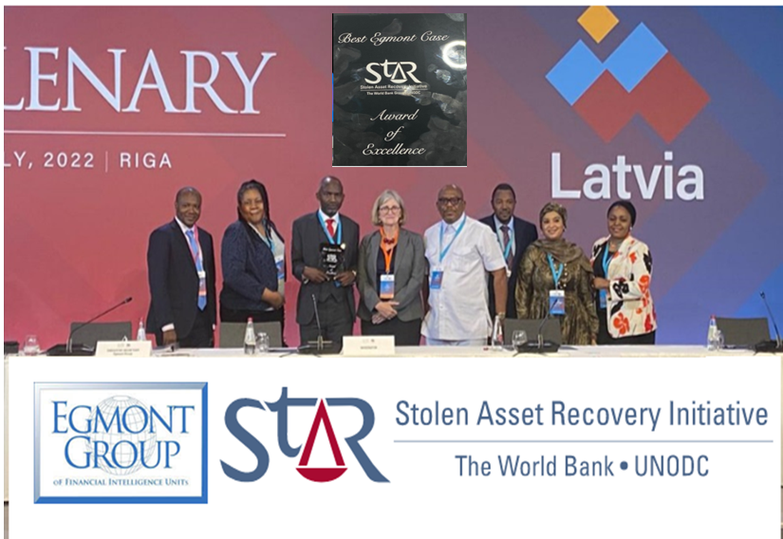


Egmont Group of Financial Intelligence Units
NFIU received the Egmont StAR Award in 2022 on behalf of Nigeria
The Stolen Asset Recovery Initiative started in 2017 a partnership between the Egmont Group, World Bank Group and the United Nations Office on Drugs and Crime.
Nigeria was declared Winner of the Award during the 28th Egmont Group Plenary meetings at Riga, Latvia, 10-15 July 2022.
The Award was as result on Case that involves Asset Tracing, Tracking and Recovery, Interagency collaboration between NFIU, EFCC and other Agencies as well as effective Synergy with Financial Institution in Nigeria and other Jurisdictions in the Complex Money Laundering Cases

Slide 27
Unique methodology, concerns and approaches applied by the NFIU in combatting illicit financial flows particularly in identifying and tracing proceeds of crime.
FIUs play a crucial role in asset tracing, recovery, confiscation, and management within the realm of combating financial crimes such as money laundering, terrorism financing, and other illicit activities. .
FIUs serve as central hubs for gathering, analyzing, and disseminating financial intelligence to support efforts to combat financial crimes, including asset tracing, recovery, confiscation, and management.
Their collaboration with domestic and international partners is essential for effectively combating money laundering, terrorism financing, and other illicit activities across borders.

Slide 28
Unique methodology, concerns and approaches applied by the NFIU in combatting illicit financial flows particularly in identifying and tracing proceeds of crime.
Information Gathering and Analysis:
Detecting Patterns of Suspicious Activity:
FIUs use sophisticated analytical tools and techniques to identify patterns of suspicious financial activity that may indicate money laundering or other illicit behavior. By analyzing large volumes of financial data, they can detect anomalies and trends that may warrant further investigation.
FIUs collect, analyze, and disseminate financial information obtained from various sources, including financial institutions, government agencies, and international partners. This information often includes suspicious transaction reports (STRs), currency transaction reports (CTRs), and other relevant data.

Slide 29
Unique methodology, concerns and approaches applied by the NFIU in combatting illicit financial flows particularly in identifying and tracing proceeds of crime.
Facilitating Asset Tracing:
Coordinating with Domestic and International Partners:
FIUs assist law enforcement agencies and other authorities in tracing the movement of illicit funds and identifying the assets acquired through criminal activity. This involves tracking financial transactions across multiple jurisdictions and uncovering the complex networks used to launder money and conceal illicit assets.
FIUs collaborate with domestic and international partners, including law enforcement agencies, regulatory bodies, and other FIUs, to share information and intelligence related to financial crimes. This collaboration is essential for tracing assets that may be located in different jurisdictions and for coordinating efforts to freeze, seize, and repatriate illicit assets.

Slide 30
Unique methodology, concerns and approaches applied by the NFIU in combatting illicit financial flows particularly in identifying and tracing proceeds of crime.
Freezing and Confiscating Assets:
Preventing Future Financial Crimes:
FIUs work closely with law enforcement agencies and judicial authorities to initiate legal proceedings for freezing and confiscating assets acquired through criminal activity. This may involve obtaining court orders, issuing asset freezes, and coordinating with financial institutions and other entities to prevent the transfer or disposal of illicit assets.
In addition to their role in supporting investigating and prosecuting financial crimes, FIUs also play a proactive role in preventing future offenses. By analyzing financial trends, identifying vulnerabilities in the financial system, and providing guidance to regulators and policymakers, FIUs help strengthen anti-money laundering (AML) and counter-terrorism financing (CTF) measures.

Slide 31


Exploring the Prospects for Synergy between the relevant Agencies for better Performance.
The success of the Asset Recovery process depends on the effective synergy of actions and extensive cooperation and coordination between authorities and agencies involved in every stage of the Process.
Therefore, one of the main essential factors for asset recovery efficiency is each competent authority's overall understanding of its role and functions in the process.
Exploring the Prospects for Synergy between the relevant Agencies for better Performance in the Asset Recovery Process is crucial because of several potential gains.

Slide 32
Exploring the Prospects for Synergy between the relevant Agencies for better Performance.
Enhanced Information Sharing:
Collaboration between agencies allows for pooling resources and information, enabling a more comprehensive understanding of asset movements and ownership.
Leveraging Specialized Expertise:
Different agencies bring unique skills and perspectives to the table. Working together can leverage each other's expertise to tackle complex cases more effectively.
Increased Efficiency:
Cooperation reduces duplication of efforts and streamlines processes, leading to faster asset recovery and case resolution.
Improved Coordination:
A coordinated approach ensures that investigations proceed smoothly and that all relevant aspects of a case are adequately addressed.

Slide 33
Exploring the Prospects for Synergy between the relevant Agencies for better Performance.
Broader Jurisdictional Reach:
Asset recovery often involves cross-border transactions. Collaboration between agencies with jurisdictional reach in different regions can facilitate the recovery of assets hidden overseas.
Enhanced Legal Frameworks:
Working together can highlight gaps in existing legal frameworks and facilitate the development of new laws or protocols to better address asset recovery challenges.
Strengthened Deterrence:
Successful asset recovery sends a strong message to perpetrators of financial crimes, acting as a deterrent and reducing the likelihood of future offences.

Slide 34
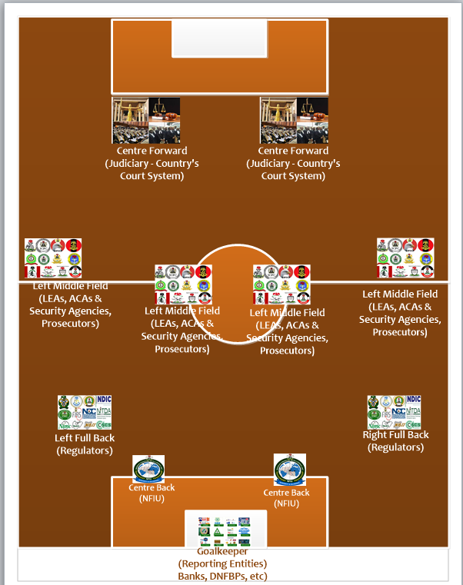
Exploring the Prospects for Synergy between the relevant Agencies for better Performance - Taking a Que from Synergy of a Football Team
A football Team's synergy is the harmonious combination of individual players' skills, attributes, and efforts that contribute to the team's overall success and effectiveness.
It's like a puzzle where each piece complements the others to create a cohesive and formidable unit on the field.
Here are some key elements of a football team's synergy: Understanding Roles, Team Spirit, Communication, Adaptability, Trust and Respect, Tactical Understanding, etc.

Slide 35
Challenges encountered by the relevant Agencies in dealing with Asset Tracing, Recovery, and Confiscation, and Recommendations that will engender more efficiency - Challenges/barriers/obstacles
01.
Fragmented Jurisdiction: Different agencies often have overlapping or fragmented jurisdictions, leading to redundancy and inefficiency.
Information Sharing Barriers: Agencies are sometimes hesitant to share sensitive information due to legal restrictions, data privacy concerns, or institutional culture.
02.
Asset Tracing, Recovery, Confiscation and Management
Divergent Priorities and Mandates: Agencies may have conflicting priorities or mandates, making aligning efforts towards asset recovery difficult.
Resource Constraints: Limited resources, including funding, personnel, and technology, can hinder collaborative efforts for asset recovery.
03.
04.

Slide 36
Challenges encountered by the relevant Agencies in dealing with Asset Tracing, Recovery, and Confiscation, and Recommendations that will engender more efficiency - Challenges/barriers/obstacles
Communication Challenges: Communication breakdowns, such as misinterpretation of information or lack of timely updates, can impede coordination efforts.
Legal and Procedural Complexities: Asset recovery processes often involve complex legal frameworks, including international laws and treaties, creating bureaucratic hurdles and delays.
05.
06.
Asset Tracing, Recovery, Confiscation and Management
Cultural Differences and Competing Organizational Cultures: Agencies may have different organizational cultures and practices, leading to misunderstandings or conflicts during collaborative efforts.
Political Interference: Political pressures or interference may influence asset recovery efforts, jeopardizing the impartiality and effectiveness of investigations.
07.
08.

Slide 37
Challenges encountered by the relevant Agencies in dealing with Asset Tracing, Recovery, and Confiscation, and Recommendations that will engender more efficiency - Challenges/barriers/obstacles
09.
Legal obstacles that prevent operational collaboration between Asset recovery Organisation (ARO) and FIU
Inability to use FIU disseminations as evidence or difficulties in transforming intelligence into evidence
10.
Asset Tracing, Recovery, Confiscation and Management
Challenges in linking assets with Money Laundering ,Terrorism Financing, or any Predicate Offence.
Lack of modern digital information exchange solutions for Asset Tracing, Tracking and Recovery.
11.
12.

Slide 38
Recommendations that will engender more efficiency in Asset Tracing, Recovery, Confiscation and Management
Implementing secure information-sharing platforms and protocols is crucial. It not only ensures the safety of data but also promotes trust and collaboration among agencies. This trust is the foundation of our successful asset recovery efforts, and it is through collaboration that Agencies can achieve our shared goals.
Establishing clear communication and collaboration protocols can help overcome this challenge. Creating multi-agency task forces or committees focused on asset recovery can facilitate coordination.
Developing a shared understanding of goals and objectives is key to fostering cooperation. It is through this shared vision that we can reconcile our differences and work towards a common goal. Establishing interagency agreements or memoranda of understanding further solidifies this cooperation, ensuring that we are all on the same page.
Pooling resources through Joint Task Forces/Joint Task Teams or leveraging specialised expertise from different agencies can maximise efficiency and effectiveness.

Slide 39
Recommendations that will engender more efficiency in Asset Tracing, Recovery, Confiscation and Management
Safeguarding the independence of investigative agencies through institutional safeguards, such as tenure protections for key personnel or oversight mechanisms, can help insulate them from undue influence.
Implementing regular meetings, standardised reporting mechanisms and communication protocols can improve information flow and facilitate decision-making.
Providing training and legal assistance to personnel involved in asset recovery and streamlining procedures where possible can mitigate these challenges.
Promoting cross-agency training, fostering a shared sense of purpose, and encouraging cultural sensitivity can help bridge these differences and build stakeholder trust.

Slide 40

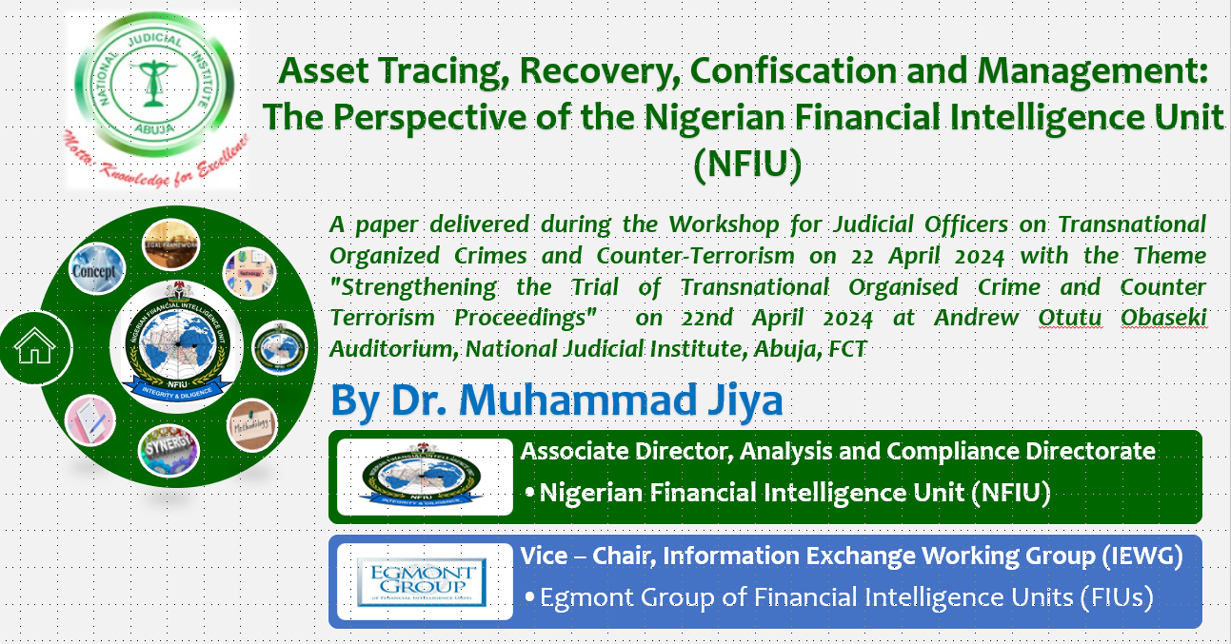



No o1, Monrovia Street, Opposite BON Hotel, Wuse II, Abuja, FCT.
+234 803 352 4944
mjiya@nfiu.gov.ng
www.nfiu.gov.ng
Thank you for your kind attention!

